Slide 1


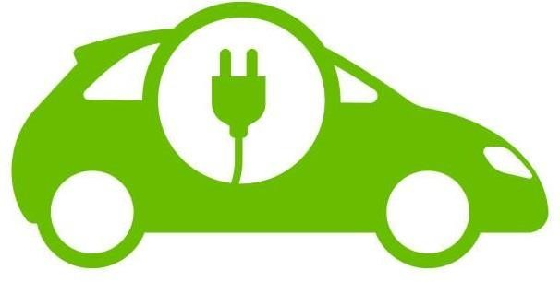
Smart charging Scheduling of EV based on seasonal uncertainty considering G2V and V2G in presence of Renewable.
GROUP MEMBERS
SOUMYADEEP BERA(12021002011001)
SHRUTI MODI(12021002011038)
RUPALI DUTTA(12021002011050)
Under the supervision of
Prof. Dr. Sourav Das
Department of Electrical Engineering,IEM Kolkata
1
1

Slide 2
Outline
Topics | Page no.
Introduction | 3
Literature Gap | 4
Problem Statement | 5
Objective | 5
Problem Formulation | 6-8
Constraints | 9-10
Solution Methodology | 11
Input and test cases | 12-17 and 25-27
Result and Analysis | 18-23 and 28-33
Cost Comparison | 24 and 34
Conclusion | 35
Future Scope | 36
References | 37-40
Publications | 41

Slide 3
Introduction
Global warming is a major issue, primarily caused by air pollution.
Internal Combustion Engine (ICE) vehicles are a significant contributor to pollution.
Electrification of vehicles is a sustainable alternative to reduce emissions and fossil fuel dependency.
EV adoption is increasing, with 40 million EV owners recorded in 2023 and projections of 200-270 million by 2030.
Despite EV growth, challenges exist, such as limited charging stations and high electricity demand.
Efficient charging strategies are necessary to balance benefits for both vehicle owners and grid operators.
Grid-to-Vehicle (G2V) and Vehicle-to-Grid (V2G) models help optimize charging costs and energy efficiency.
Seasonal driving cycles impact charging patterns, requiring optimal scheduling approaches.
Photovoltaic (PV)-powered charging stations reduce dependence on fossil-based electricity.
Seasonal fluctuations in solar irradiance affect PV system efficiency and energy availability.

Slide 4
Literature Gap
Limited Research on Seasonal Impact in EV Scheduling
From [1], it is observed that most studies focus on static EV charging models without considering seasonal variations in driving patterns, battery performance, and energy consumption.
From [2], we see that winter conditions increase energy use by 30% due to battery heating and reduced efficiency, yet most scheduling models fail to incorporate such variations.
Inadequate Consideration of Renewable Energy Variability
From [3], it is noted that while some studies integrate solar and wind energy into EV charging, they fail to model seasonal fluctuations in renewable generation and their impact on G2V and V2G operations.
From [4], research shows that PV integration enhances EV charging sustainability, but most models do not adapt dynamically to changing renewable energy patterns.
Lack of Optimization Models Addressing Seasonal Charging Uncertainty
From [5], we observed that differential evolution (DE) techniques are effective for multi-objective optimization, but existing models do not fully incorporate seasonal variations in EV charging uncertainties.
From [6], studies highlight that PEV scheduling models can reduce grid peak load, but they fail to integrate driving pattern variations within seasonal charging cycles.

Slide 5
Objective
Problem Statement
EV charging costs vary due to uncertainties in driving patterns, seasonal temperature changes, and electricity demand.
Unregulated G2V & V2G operations lead to higher costs, battery degradation, and grid instability during peak demand.
Lack of smart scheduling reduces renewable energy utilization and increases expenses.
Need for an optimized charging strategy to minimize costs, enhance power efficiency, and ensure grid stability under seasonal uncertainties.
Optimize EV charging under seasonal uncertainty to minimize costs while ensuring grid stability through G2V and V2G operations.
Integrate renewable energy into EV charging to reduce grid dependency and enhance cost efficiency using G2V, V2G, and P2V modes.

Slide 6
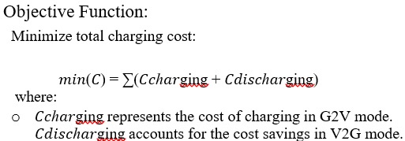
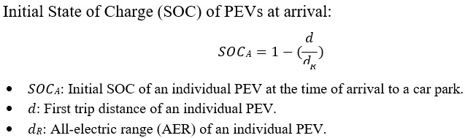
Problem formulation
.....(1)
Energy Modelling:
….(2)

Slide 7
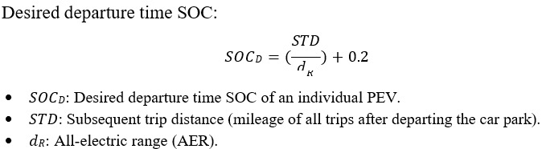
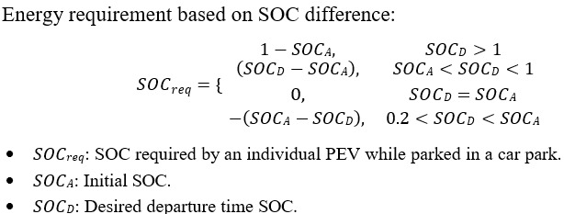
....(3)
.....(4)

Slide 8
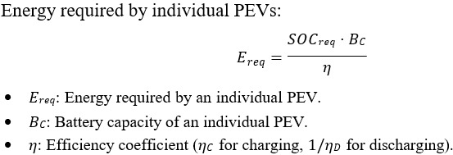
.....(5)

Slide 9
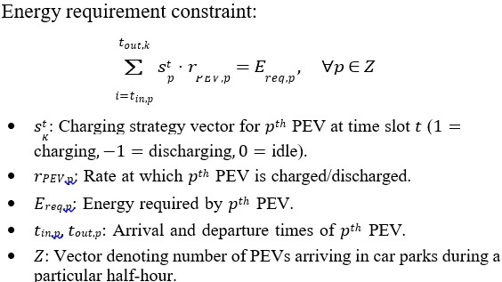
Constraints
.....(6)

Slide 10
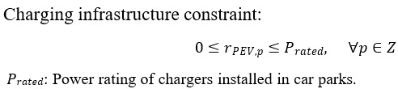
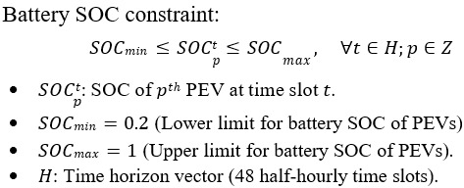
.....(7)
.....(8)

Slide 11
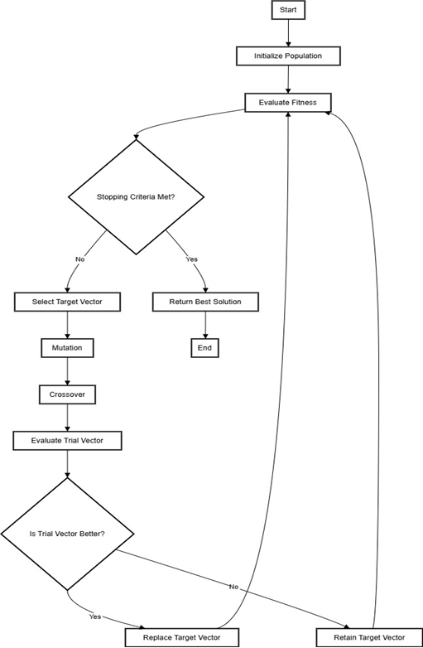
Solution methodology

Slide 12
Input and Test Cases Table no-1: This table shows the percentage of type of vehicles taken for two test cases: HBC and LBC
Test Cases | BEV | PHEV 40 | PHEV30
Case : 1(HBC) | 50% | 30% | 20%
Case : 2(LBC) | 20% | 30% | 50%

Slide 13
Table 2: This table shows the mean and standard deviation values considered for all the driving cycles for three seasons
Season | Driving Cycle | Mean | Standard Deviation
Summer | Daily Mileage(km) | 55 | 10
 | First Trip Distance(km) | 18 | 8.41
 | Arrival Time(hours) | 16 | 1.2
 | Departure Time(hours) | 22 | 1.2
Monsoon | Daily Mileage(km) | 41 | 8
 | First Trip Distance(km) | 15 | 5.41
 | Arrival Time(hours) | 16 | 1.2
 | Departure Time(hours) | 22 | 1.2
Winter | Daily Mileage(km) | 32 | 6
 | First Trip Distance(km) | 11 | 3.41
 | Arrival Time(hours) | 16 | 1.2
 | Departure Time(hours) | 22 | 1.2

Slide 14
Dynamic Tariff for all three seasons
Coordinated Charging Scheduling requires dynamic tariff rates for G2V & V2G operations.
Seasonal Power Tariff Analysis for summer, monsoon, and winter.
The Dynamic tariff is fetched from [13], where at 30 mins interval the price is changing
PV Integration lowers dynamic tariff rates.
Comparative Analysis has been done in Fig 1.,Fig 2.,Fig 3.

Slide 15
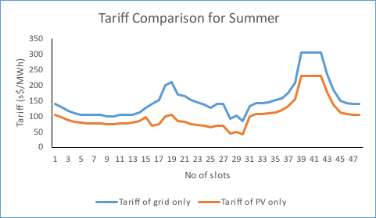
Fig 1. Tariff comparison for Summer

Slide 16
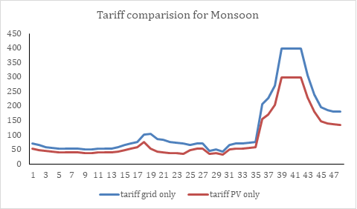
Fig 2. Tariff comparison for Monsoon

Slide 17
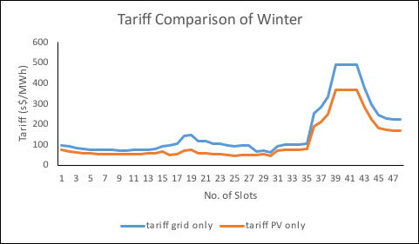
Fig 3. Tariff comparison for Winter

Slide 18
Result and Analysis:
For Summer: For HBC Vehicles
Fig 4. Charging strategy for HBC set of vehicles for summer
In this charging strategy we can see white spaces are more which shows discharging and the dark blue spaces are less which shows charging.

Slide 19
For LBC Vehicles:
Fig 5. Charging strategy for LBC set of vehicles for summer
In this charging strategy we can see dark blue spaces are more which shows charging and the white spaces are less which shows discharging.

Slide 20
For Monsoon For HBC Vehicles:
Fig 6. Charging strategy for HBC set of vehicles for monsoon
In this charging strategy we can see white spaces are more which shows discharging and the dark blue spaces are less which shows charging.

Slide 21
For LBC Vehicles:
Fig 7. Charging strategy for LBC set of vehicles for monsoon
In this charging strategy we can see dark blue spaces are more which shows charging and the white spaces are less which shows discharging

Slide 22
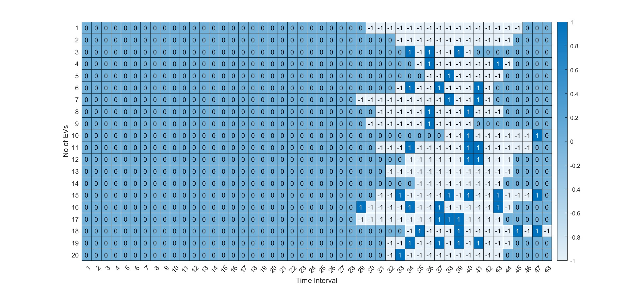
For Winter For HBC Vehicles
Fig 8. Charging strategy for HBC set of vehicles for winter
In this charging strategy we can see white spaces are more which shows discharging and the dark blue spaces are less which shows charging.

Slide 23
For LBC Vehicles
Fig 9. Charging strategy for LBC set of vehicles for winter
In this charging strategy we can see dark blue spaces are more which shows charging and the white spaces are less which shows discharging

Slide 24
Cost Comparison:
Table 3: This table shows the mean and standard deviation values considered for all the driving cycles for three seasons
Seasons | HBC | LBC
Summer | -1.3511 | 2.2226
Monsoon | -1.2108 | 0.1271
Winter | -3.5168 | 1.366
From the data provided, we can observe that profit has been made in all three seasons for HBC, as the negative values indicate greater vehicle-to-grid (V2G) activity, resulting in profit. Among the seasons, the maximum profit is observed in winter, with a value of -3.5168, indicating the highest V2G activity compared to summer and monsoon.
Comparison (from graphs)
From the above graphs we can observe the vehicle undergoes maximum discharging in case of HBC even when we have higher tariff rates
Secondly among three seasons, maximum V2G is seen in case of winter, followed by monsoon and summer.
18

Slide 25
Input Data & Test Case
Location: Durgapur, India (23.533440° N, 87.321930° E)
Solar Data Source: Renewables.ninja[20]
Data Period: 90 days per season
Summer: April - June
Monsoon: July - September
Winter: November - January

Slide 26
Peak Solar Output Duration Across Seasons
Analysis of Solar Power Output Data
Identified mean peak time for each season
Crucial for optimizing EV charging schedules
Helps in energy planning and battery storage strategies
Peak Solar Output Timings:
Summer: 8:00 AM - 3:00 PM
Monsoon: 9:30 AM - 12:30 PM
Winter: 8:00 AM - 2:00 PM

Slide 27
Driving Cycle Analysis:
Table 4: This table shows the mean and standard deviation values considered for all the driving cycles for three seasons
Season | Driving Cycle | Mean |  | Standard Deviation
Summer | Daily Mileage(km) | 55 |  | 10
 | First Trip Distance(km) | 18 |  | 8.41
 | Arrival Time(hours) | 9 |  | 1.2
 | Departure Time(hours) | 19 |  | 1.2
Monsoon | Daily Mileage(km) | 41 |  | 8
 | Firs Trip Distance(km) | 15 |  | 5.41
 | Arrival Time(hours) | 11 |  | 1.2
 | Departure Time(hours) | 18 |  | 1.2
Winter | Daily Mileage(km) | 32 |  | 6
 | First Trip Distance(km) | 11 |  | 3.41
 | Arrival Time(hours) | 11 |  | 1.2
 | Departure Time(hours) | 17 |  | 1.2
ALL THE DRIVING CYCLES FOLLOW NORMAL DISTRIBUTION [2]

Slide 28
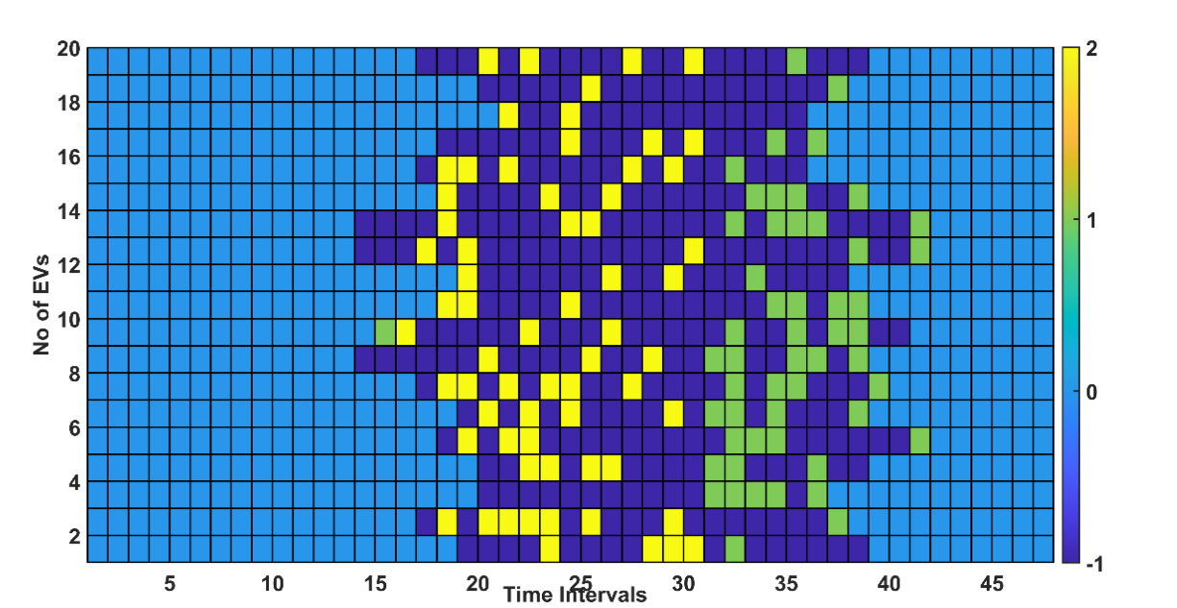
Summer:(High Solar Yield) For HBC Vehicles: :
Fig 10. Charging strategy for HBC set of vehicles for summer
From Fig 10. we can observe that in summer for HBC set of vehicle, PV charging is at its highest (3.96%), taking advantage of strong solar availability. However, due to increased energy demand, particularly for cooling and extended driving cycles, V2G discharge is at its peak (17.59%).

Slide 29
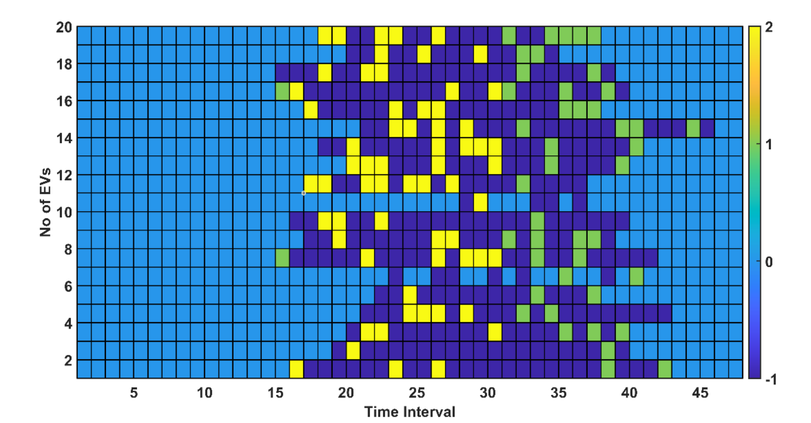
For LBC Vehicles:
Fig 11. Charging strategy for LBC set of vehicles for summer
From Fig 11. we can observe that during the summer season, for LBC set of vehicles, PV charging is at its highest at 3.91%, maximizing solar energy utilization. Grid charging remains minimal at 0.09%, showing continued reliance on renewables.

Slide 30
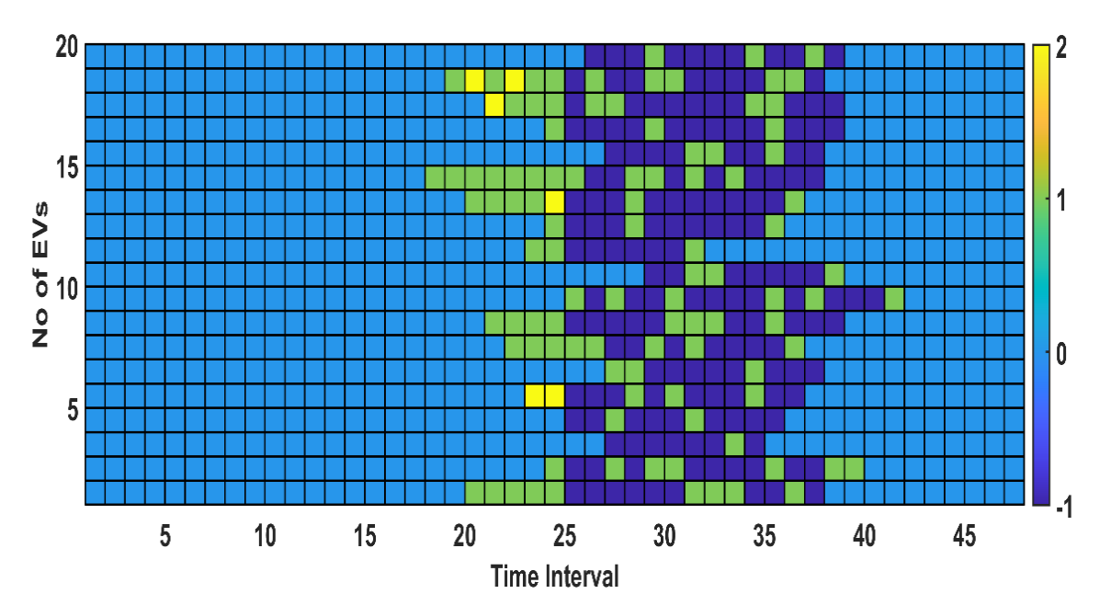
Monsoon (Intermittent Solar Supply) For HBC set of vehicles:
Fig 12. Charging strategy for HBC set of vehicles for monsoon
From Fig 12.,we can observe that in monsoon, for HBC set of vehicles PV charging drops to its lowest level (0.56%) due to cloudy weather and reduced sunlight availability. V2G discharge is recorded at 10.84%, which is higher than in winter but lower than in summer.

Slide 31
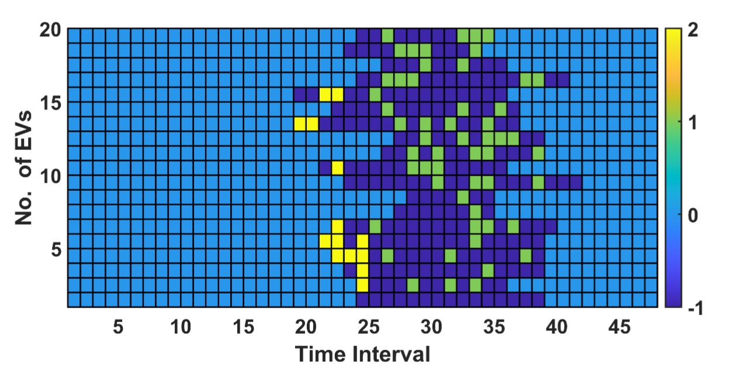
For LBC set of vehicles:
Fig 13. Charging strategy for LBC set of vehicles for monsoon
From Fig 13. we can observe that during the monsoon season for LBC set of vehicles, PV charging slightly improves to 1.87%, but it remains relatively low due to reduced solar availability caused by cloud cover. Grid charging is minimal at 0.004%, indicating very little direct reliance on the grid. To compensate for the lack of solar input, V2G discharge increases to 12.53%, ensuring energy stability.

Slide 32
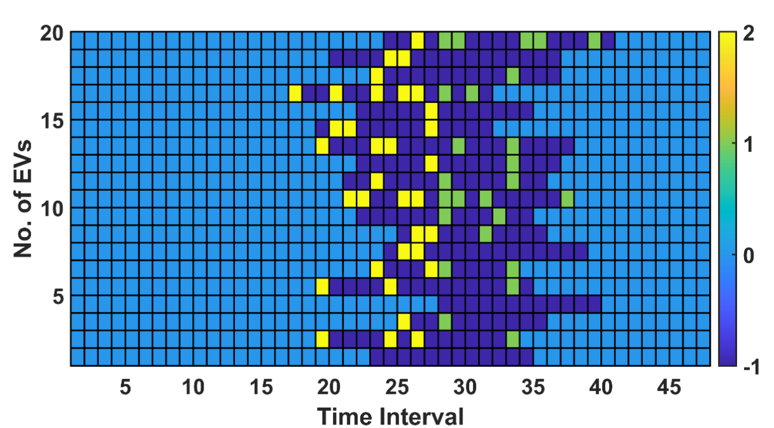
Winter (Low Solar Yield) For HBC set of vehicles:
Fig 14. Charging strategy for HBC set of vehicles for winter
From Fig 14., we can observe that for HBC set of vehicles PV charging decreases to 2.06% due to shorter daylight hours and lower solar irradiance. Grid charging remains minimal at 0.09%, indicating a continued preference for renewable energy sources. However, V2G discharge is at its lowest (9.08%), which aligns with the reduced driving demand and the need to conserve battery power in colder temperatures.

Slide 33
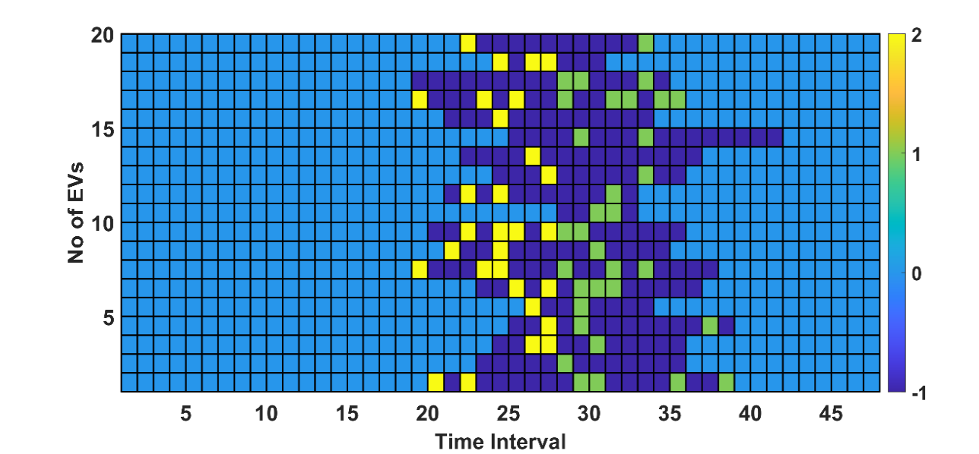
For LBC set of vehicles:
Fig 15. Charging strategy for LBC set of vehicles for winter
From Fig 15., we can observe that in the winter season, for LBC set of vehicles PV charging is extremely low at 0.96%. Grid charging is almost negligible at 0.002%, reinforcing the preference for renewable and stored energy sources. V2G discharge reaches 11.34%, slightly lower than in monsoon aligning with the reduced energy demands of winter.

Slide 34
Cost Comparison:
Table 5: This table shows the mean and standard deviation values considered for all the driving cycles for three seasons
Season | PV Contribution | Grid Load Reduction | User Savings | V2G Revenue
Summer | 60–80% | 40–50% | 20–35% | 0.10–0.15/kWh
Monsoon | 30–50% | 20–30% | 15–25% | 0.05–0.10/kWh
Winter | 20–40% | 10–20% | 10–15% | 0.03–0.08/kWh
Summer:
Highest PV utilization (75% of charging demand).
$120/day savings for a 50-EV station.
Monsoon:
Predictive scheduling improves reliability despite cloud cover.
Winter:
Hybrid PV-grid charging still achieves 15% cost savings.

Slide 35
Conclusions
PV-Integrated Charging reduces grid dependency and optimizes seasonal energy use.
Maximum PV Charging occurs in summer due to abundant solar resources.
PV Supply Drops in monsoon and winter, increasing V2G discharging.
Grid Charging Remains Minimal, proving system efficiency.
V2G Discharge is lowest in summer and highest in winter
Energy Equilibrium Maintained through optimized PV use and V2G adjustments.
Boosts Sustainability by reducing grid reliance and ensuring optimal EV energy management year-round.

Slide 36
Future Scope
Optimizing charging station placement is crucial for minimizing energy losses, improving grid efficiency, and ensuring sustainable EV integration.
Future research directions include leveraging AI-driven optimization, renewable energy integration, dynamic load management, and economic feasibility studies.
These advancements will contribute to a smart, efficient, and resilient EV charging infrastructure.

Slide 37
References
[1]I. Veza et al., "Electric vehicle (EV) and driving towards sustainability: Comparison between EV, HEV, PHEV, and ICE vehicles to achieve net zero emissions by 2050 from EV," Alexandria Eng. J., vol. 82, pp. 459-467, 2023.
[2]T.F. Baker, "Transportation CO2 Emissions in Automotive Life Cycle Assessments of Electric Vehicles-a Systems Theory Evaluation," J. Clean. Prod., 2024.
[3]A.K. Singh, R. Kumar, B. Kumar and D.K. Chaturvedi, "Fundamentals of modern transportation systems," in Intelligent Control for Modern Transportation Systems, CRC Press, 2023, pp. 1-20.
[4]S.M. Ugarthi, "A Critical Analysis on the Need for Electric Vehicles Tax Deductions and Subsidies in the Modern Times in India," Int'l JL Mgmt. & Human., vol. 7, no. 4, p. 2217, 2024.
[5]G. Nallathambi et al., "Evolution of India EV Ecosystem," J. Clean Energy Technol., 2022.
[6]L. Chen and R. Ma, "Clean energy synergy with electric vehicles: Insights into carbon footprint," Energy Strategy Rev., vol. 53, p. 101394, 2024.
[7]I. INDIA, "India's Potential in the Midstream of Battery Production," Renew. Sustain. Energy Rev., 2023.
[8]S. Mohanty et al., "Demand side management of electric vehicles in smart grids: A survey on strategies, challenges, modeling, and optimization," Energy Rep., vol. 8, pp. 12466-12490, 2022.
[9]M. Senol et al., "Electric vehicles under low temperatures: A review on battery performance, charging needs, and power grid impacts," IEEE Access, vol. 11, pp. 39879-39912, 2023.
[10]A. Gurusamy and B. Ashok, "Road segment and driving schedule effects in real-time operation on electric vehicle performance and operating cost analysis," Proc. Inst. Mech. Eng. D, J. Automob. Eng.,
p. 09544070231217570, 2023.

Slide 38
[11]H. Rauf, M. Khalid and N. Arshad, "Machine learning in state of health and remaining useful life estimation: Theoretical and technological development in battery degradation modelling," Renew. Sustain. Energy Rev., vol. 156, p. 111903, 2022.
[12]G. Chen and Z. Zhang, "Control strategies, economic benefits, and challenges of vehicle-to-grid applications: Recent trends research," World Electr. Veh. J., vol. 15, no. 5, p. 190, 2024.
[13]S. Hossain et al., "Grid-vehicle-grid (G2V2G) efficient power transmission: An overview of concept, operations, benefits, concerns, and future challenges," Sustainability, vol. 15, no. 7, p. 5782, 2023.
[14]K. Park and I. Moon, "Multi-agent deep reinforcement learning approach for EV charging scheduling in a smart grid," Appl. Energy, vol. 328, p. 120111, 2022.
[15]M.U. Nawaz, M.S. Qureshi and S. Umar, "Integration of solar energy systems with electric vehicle charging infrastructure: challenges and opportunity," Rev. Esp. Doc. Cient., vol. 18, no. 2, pp. 1-18, 2024.
[16]S. Panchanathan et al., "A comprehensive review of the bidirectional converter topologies for the vehicle-to-grid system," Energies, vol. 16, no. 5, p. 2503, 2023.
[17]P. Barman et al., "Renewable energy integration with electric vehicle technology: A review of the existing smart charging approaches," Renew. Sustain. Energy Rev., vol. 183, p. 113518, 2023.
[18]W.L. Liu et al., "Heterogeneous multiobjective differential evolution for electric vehicle charging scheduling," in Proc. IEEE Symp. Ser. Comput. Intell. (SSCI), 2021, pp. 1-8.
[19]Q. Meng et al., "Revolutionizing photovoltaic consumption and electric vehicle charging: A novel approach for residential distribution systems," IET Gener. Transm. Distrib., vol. 18, no. 17, pp. 2822- 2833, 2024.
[20]"Solar data of Durgapur, West Bengal, India," Renewables Ninja. [Online]. Available: https://www.renewables.ninja. Accessed: Mar. 14, 2025.

Slide 39
[21] I. Ali and M. Khalid, "A differential evolution algorithm for multi-objective plug-in electric vehicle charging scheduling," Int. J. Electr. Power Energy Syst., vol. 99, pp. 85-97, 2018.
[22] H. Fathabadi, "Novel battery pack design for improving the performance of electric vehicles at low temperatures," Energy, vol. 118, pp. 1180-1190, 2017
.
[23] J.H. Lee, S. Hardman and G. Tal, "Who is buying electric vehicles in California? Characterizing early adopter heterogeneity and forecasting market diffusion," Energy Res. Soc. Sci., vol. 39, pp. 190-204, 2018.
[24] J. Luo, L. Zhang and Y. Wang, "Stochastic optimization for plug-in electric vehicle charging scheduling considering grid constraints," IEEE Trans. Smart Grid, vol. 11, no. 5, pp. 4217-4229, 2020.
[25] A.C. Mersky et al., "Effectiveness of incentives on electric vehicle adoption in Norway," Transp. Res. D, Transp. Environ., vol. 46, pp. 56-68, 2016
.
[26] J. Neubauer, A. Brooker and E. Wood, "Sensitivity of battery electric vehicle economics to drive patterns, vehicle range, and charge strategies," J. Power Sources, vol. 245, pp. 570-577, 2014.
[27] X. Wang, Y. Li and Z. Zhang, "Heuristic optimization algorithms for smart grid applications: A review," Renew. Sustain. Energy Rev., vol. 113, p. 109281, 2019.
[28] T. Zhou, X. Li and H. Chen, "Seasonal-aware charging scheduling for plug-in electric vehicles with renewable integration," IEEE Trans. Sustain. Energy, vol. 12, no. 3, pp. 1452-1463, 2021.
[29] R. Storn and K. Price, "Differential evolution - A simple and efficient heuristic for global optimization over continuous spaces," J. Global Optim., vol. 11, no. 4, pp. 341-359, 1997.
[30] K. Deb et al., "A fast and elitist multi-objective genetic algorithm: NSGA-II," IEEE Trans. Evol. Comput., vol. 6, no. 2, pp. 182-197, 2002.

Slide 40
[31] C.A. Coello Coello, "Evolutionary multi-objective optimization: A historical view of the field," IEEE Comput. Intell. Mag., vol. 1, no. 1, pp. 28-36, 2006.
[32] Q. Zhang and H. Li, "MOEA/D: A multi-objective evolutionary algorithm based on decomposition," IEEE Trans. Evol. Comput., vol. 11, no. 6, pp. 712-731, 2007.
[33] J. Kennedy and R. Eberhart, "Particle swarm optimization," in Proc. Int. Conf. Neural Netw. (ICNN), 1995, vol. 4, pp. 1942-1948.
[34] S. Das and P.N. Suganthan, "Differential evolution: A survey of the state-of-the-art," IEEE Trans. Evol. Comput., vol. 15, no. 1, pp. 4-31, 2011.
[35] E. Mezura-Montes and C.A. Coello Coello, "Constraint-handling in nature-inspired numerical optimization: Past, present and future," Swarm Evol. Comput., vol. 1, no. 4, pp. 173-194, 2011.
[36] M. Zhang et al., "Optimal scheduling of electric vehicle charging with renewable energy integration in microgrids," IEEE Trans. Smart Grid, vol. 10, no. 3, pp. 2946-2957, 2019.
[37] Y. Wang and Z. Li, "Battery degradation modeling and remaining useful life prediction for electric vehicles," IEEE Trans. Ind. Informat. [38] L. Wu et al., "A review on electric vehicle charging infrastructure development in China," Renew. Sustain. Energy Rev., vol. 137, p. 110461, 2021.
[39] S. Rahman et al., "Impact of electric vehicle charging on power distribution systems: A comprehensive review," Energies, vol. 14, no. 13, p. 3786, 2021.
[40] P. Richardson et al., "Electric vehicle fast charging station usage and power requirements," Energy, vol. 248, p. 123588, 2022.

Slide 41
PUBLICATIONS
[1] S.Das, S. Modi, S. Bera, R. Dutta “Optimal Scheduling of Plugin Electric Vehicles Considering Seasonal Uncertainty,” International Conference on Recent Innovations in Energy Management and Renewable Resources, Springer LNEE, 2024 (IEMRE 2024) (presented)
[2] S. Das, S. Bera, S. Modi, R. Dutta, “Electric Aircraft Charging: Current Status, Evolving Trends, and Hurdles”, IEEE North-East India International Energy Conversion Conference and Exhibition (communicated)

Slide 42
THANK YOU

